Slide 1
Sale of Personal Residence
Pub 4012 – Tab D Pub 4491 – Lesson 11
Notes:
1
For basis of gifted property or inherited property, refer to the Capital Gain lesson
Comprehensive topics at the end of this lesson include

Slide 2
Lesson Topics
Personal residence defined
Principal residence defined
Principal residence exclusion
Cost basis of personal residence
TaxSlayer entries
Comprehensive topics
Notes:
Comprehensive topics
Basis for surviving spouse
Special rules for surviving spouse
Reduced exclusion
Suspension of 5-year test period

Slide 3
The Interview
Intake and Interview form:
Exclusion of canceled qualified home mortgage debt income expired 12/31/17 and is out of scope
Notes:
Home could be sale of inherited home or a vacation home
Must have been used as a residence
Never a rental or used in a business (home office)

Slide 4
Personal Residence Defined
Lived in by taxpayer or family member (15 days during a year)
If ever rented out or used in a business – out of scope
Exception: 14 day rental (or less) allowed during year
Home is non-investment asset
Capital asset for gains
Gain on sale = capital gain
Exclusion if satisfies main home tests
Personal asset for losses
Loss on sale = nondeductible personal loss
Notes:
A home includes any property used as a residence
Second home
House boat
Mobile home
If home was ever rented out or used in business, out of scope
Except simplified home office deduction
Except the 15 days or less rental exclusion

Slide 5
Gain on Principal Residence Exclusion
Pub 523
Exclusion of gain
Up to $250,000 ($500,000 MFJ)
Must meet both eligibility tests:
Ownership Test
Use Test
Can not have excluded gain on another principal residence (main home) within two years of the sale date
Notes:
Emphasize
Taxpayer needs to determine the sales price
Taxpayer needs to determine total cost of their home, including improvements
If the taxpayer does not have this information, they will need to compile it and return another day
Taxpayer can refer to IRS Pub 523 Selling Your Home for more information

Slide 6
Principal Residence Defined
Principal residence (main home)
Where taxpayer lives most of the time
Can be house, houseboat, mobile home, condo or co-op
Must have cooking, sleeping and bathroom facilities
More than one home?
Home taxpayer lives in most of the time = main home
Taxpayer cannot simply “choose”

Slide 7
Eligibility Tests for Exclusion of Gain
During 5 years ending with date of sale:
Ownership test:
Owned the home for at least two years
Use test:
Lived in home as main home for at least two years
The two-year periods do not have to be continuous nor overlapping
Notes:
Two years defined as: 24 full months or 730 days (365 x 2)
Ownership and use tests can be met during different two-year periods
However, a taxpayer must meet both tests during the five-year period ending on the date of the sale
See Comprehensive Topics for suspension of the 5-year test period

Slide 8
Exclusion of Gain on Principal Residence
Special rule
Home is considered used as home during short-term absences (even if rented out, but that would be out of scope)

Slide 9
Exclusion – Married Taxpayers
Married taxpayers’ $500,000 exclusion when all apply:
Must file joint return
Either spouse meets ownership test
Both individuals meet use test
Neither one excluded gain in two years before sale of current home
Otherwise, apply the tests to see if one spouse qualifies for $250,000 exclusion
Unmarried taxpayers with jointly owned home may each independently qualify for $250,000 exclusion
Notes:
If not eligible for maximum exclusion, the most they can claim is the total of the maximum exclusions each would qualify for if not married and the amounts were figured separately
For this purpose, each spouse is treated as owning the property during the period that either spouse owned the property

Slide 10
Reporting Sale of Personal Residence
Report on tax return if
Any part of gain is taxable
Received Form 1099-S
No gain or gain less than exclusion – and no Form 1099-S received – reporting not required
Form 1099-S often issued at closing and included in closing documents
Notes:
Taxpayers should examine closing documents for possible 1099-S

Slide 11
Sale of Other Personal Residence
Pub 523
If not principal residence (main home)
No exclusion allowed
Gain is taxable capital gain
Loss is not deductible
Residence ever rented or used in business – out of scope
Sale of inherited or gifted home used as personal residence in scope if basis provided
Notes:
Other home does not need to be the taxpayer’s principal residence to be in scope
Can be inherited or gifted
For basis of gifted property or inherited property, refer to the Capital Gain lesson

Slide 12
Determining Cost Basis (taxpayer’s responsibility)
Pub 523
Purchase price of property
Add fees and expenses paid at purchase
Legal fees, recording fees, transfer fees, title insurance, etc.
Do not include financing fees, homeowner dues, property taxes, rent paid for early occupancy, etc.
Add improvements that increase value of home
Refer to Pub 523 Selling your Home for other adjustments to basis
Notes:
Comprehensive

Slide 13
Determining Cost Basis
NTTC-modified Pub 4012
Includes repairs done as part of larger improvement, e.g., painting exterior after adding a room
Review examples in NTTC Modified Pub 4012
Notes:
Comprehensive

Slide 14
Determining Cost Basis
Not included in cost basis
Repairs
Routine painting
Fixing roof leaks
Improvement later replaced
If you re-roof twice, only last roof can be included
Notes:
Comprehensive

Slide 15
Determining Gain on Sale
Determine the gain (or loss)
Amount realized on sale
Less cost basis
Taxpayer must provide sale price and cost basis information
Remember inherited or gifted property basis rules (see comprehensive topics at the end of this lesson)
Notes:
Comprehensive

Slide 16
Quiz 1: Can the Exclusion of Gain be Claimed?
John purchased a condo in 2004 and lived in it until 2019 (when he put it up for sale)
Beverly was divorced in 2005 and has lived in her home since then until
John and Beverly married in 2018 and began living together in Beverly’s home
John sold his condo in 2019 for a $300,000 gain
Does John qualify to exclude the gain if MFJ?

Slide 17
Quiz 1: Answer
Does John qualify to exclude the gain if MFJ?
Ownership test – yes, he owned since 2004
Use test – yes for John; but was not Beverly’s main home for 2 years during 5 years preceding sale
So can exclude up to $250,000 only

Slide 18
Quiz 2: Can These be Added to Basis?
Kitchen remodel
Fixing a leaky pipe
New furnace
2nd new furnace
Yes
No
Yes
Remove cost of 1st, add 2nd

Slide 19
Sale of Principal Residence TaxSlayer Entry
Enter as capital gain transaction and select appropriate adjustment code
To claim exclusion of gain
To remove nondeductible loss
Or
Use TaxSlayer Sale of Home Worksheet
See Pub 4012 Tab D for use of this worksheet
Can be used to detail the various costs and improvements
Not required and will not be transmitted to IRS
Notes:
The TaxSlayer worksheet calls for many details and can be confusing
If taxpayer has already computed sales price (gross as per 1099-S) and basis, including selling expenses, probably easier to enter directly in capital gain input form

Slide 20
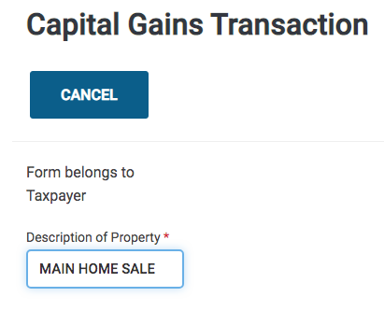
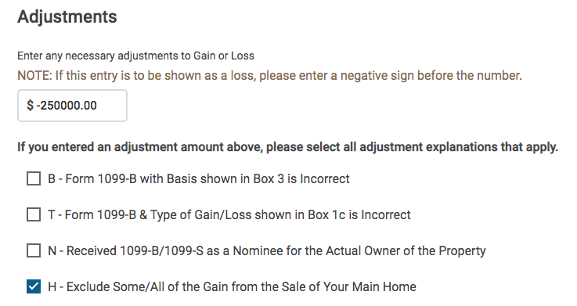
Direct Entry: Excluding Gain
Enter the amount of gain to be excluded as a negative number

Slide 21
Direct Entry: Nondeductible Loss
Enter the amount of nondeductible loss as a positive number
Notes:
More uncommon

Slide 22
TaxSlayer Sale of Home Worksheet
Information entered on Sale of Home Worksheet
Gain will transfer to Scheduled D
Excludible gain will be adjusted by TaxSlayer
Caution: home sold at a loss will not transfer to Form 8949 or Schedule D
With Form 1099-S and home sold at loss: manually enter home sale on Schedule D and adjust the loss to zero (code L)
Notes:
Worksheet often is too hard to use

Slide 23
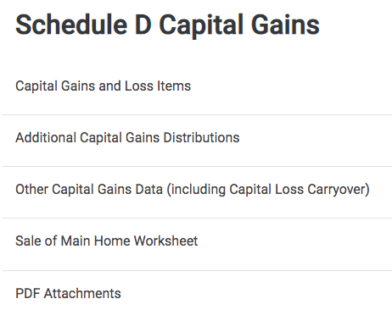
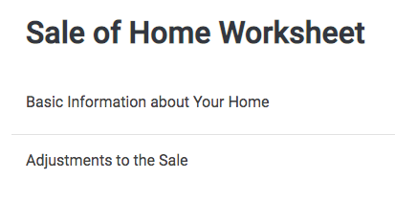
TaxSlayer Sale of Home Worksheet

Slide 24
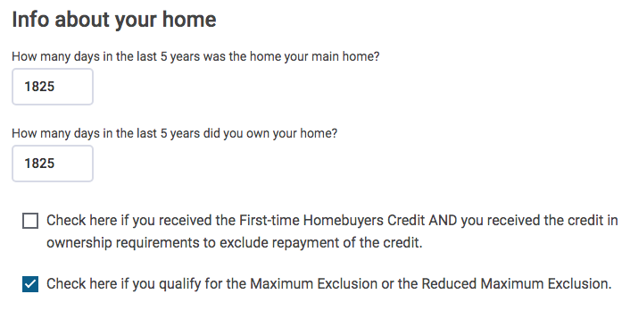
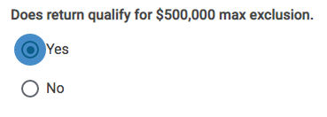
TaxSlayer Sale of Home Worksheet
Calculate number of days:
1825 days in 5 years –
leap years ignored
Check if qualified for full exclusion
Defaults to No –
Check Yes if qualified for full exclusion

Slide 25
Sale of Personal Residence Quality Review
Verify that gross amount reported on Form 1099-S and Schedule D match
IRS matches the Form 1099-S
Selling expenses should be added to basis
Confirm all tests met if claiming exclusion of gain from sale of main home
Confirm no losses claimed on sale of personal assets

Slide 26
Comprehensive Topics
Notes:
For basis of gifted property or inherited property, refer to the Capital Gain lesson
Comprehensive topics include
Basis for surviving spouse
Basis for gifted home
Special rules for surviving spouse
Reduced exclusion
Suspension of 5-year test period

Slide 27
Basis for Surviving Spouse
Basis in surviving spouse’s hands (assuming survivor now 100% owner)
Depends on whether separate property or community property (next slide)
Legal determination that taxpayer must provide
In either case, can significantly reduce gain
Notes:
Comprehensive
Depending on your state:

Slide 28
Basis for Surviving Spouse - Example
 | Separate Property State | Community Property State
100% of Cost | $50,000 | $50,000
100% value on date of death | $80,000 | $80,000
Basis to survivor | ½ of $50,000 (survivor’s half) = $25,000 ½ of $80,000 (inherited half) = $40,000 Total basis to survivor = $65,000 | $80,000
 | Decedent’s half steps to value on date of death (up or down) | Entire property steps to value on date of death (up or down)
Notes:
Assumes property owned ½ by each spouse

Slide 29
Basis for Gifted Home - Example
 | To Measure Gain | To Measure Loss (nondeductible)
100% of cost to donor | $50,000 | $50,000
100% of value on date of gift | $80,000 | $80,000
Basis to donee | Use higher of cost to donor or value | Use lower of cost to donor or value
 | $80,000 | $50,000
Note: Sale between $50,000 and $80,000 results in no gain or loss Taxpayer must provide basis – otherwise out of scope
Notes:
Assumes property owned ½ by each spouse

Slide 30
Special Rule for Surviving Spouse
Unmarried surviving spouse can claim exclusion of gain up to $500,000
Sale must occur no later than two years after date of spouse’s death
The married taxpayer conditions were met immediately before the death
Will need to enter directly in TaxSlayer
Do not use the worksheet
Notes:
Clarify
This is different than the qualifying widow(er) with child status

Slide 31
Reduced Exclusion
Reduced exclusion may be possible
If eligibility tests not met due to
Change of employment
Unforeseen circumstances (e.g. health)
Be aware of reduced exclusion possibility
Returns eligible for reduced exclusion are out of scope
Notes:
Possible reduced exclusion? See Pub 523 “Selling Your Home” page 6 Figuring Gain or Loss and go through the How to Figure Your Gain or Loss Worksheet to determine if any basis adjustments might be necessary.

Slide 32
Suspension of 5-year Test Period
Pub 523
Special rules for military, intelligence, and Peace Corp personnel
Suspension of 5-yr test period
See Pub 523
Notes:
Comprehensive

Slide 33
Sale of Personal Residence

